Slide 1
Piano Performance: Group classes for the Lifelong Learner
The Frances Clark Center, 25 October 2023
Dr Elizabeth Haddon, University of York, UK

Slide 2
Structure of the presentation
Relevance of educator’s prior experience
Context of the research
Key points
Please get in touch if you’d like a copy of the article: liz.haddon@york.ac.uk

Slide 3
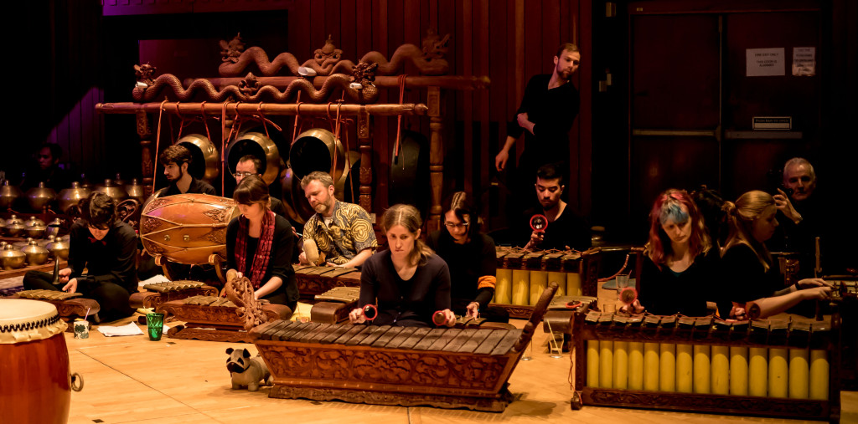
My experience
Piano learning – one-to-one
‘informal’ play-throughs
Festivals, concerts, competitions
Logical progression to giving one-to-one lessons (piano, violin, theory)
Javanese gamelan learning – group

Slide 4
Where’s our Focus?
Attentive focus
Outward attentive focus?

Slide 5
Sychronization
Collaboration, group ethos
Critical thinking skills
→ informing future pedagogical work, useful capabilities and qualities

Slide 6
University of York, UK

Slide 7
Piano performance course
10 week course
2 hours, Saturday mornings
8 adult participants
None known to each other
None my students
Level – ABRSM Grade 5 and above
Sharing playing, performance thoughts, practice ideas, duets, trios

Slide 8
Mini survey, start of Sessions
Participant aims:
Gain experience, confidence, and explore social aspects of the group format including playing duets
Memorisation: “can’t even play Happy Birthday with confidence”
Learn about using the sustaining pedal, and ornamentation.
Help their motivation, their practising, lead to improvement, and for one participant, inform their own piano teaching
Broaden their repertoire awareness, be able to play pieces from beginning to end
Restore lapsed skills
Create realistic awareness: “gain more patience in trying to master new pieces, take more time and consideration, perhaps also realise my limitations!”

Slide 9
Enjoyment of piano playing:
An ‘absorbing activity’ in which they could explore emotions: a particularly intense “experience of taking me completely outside of myself and the world around me and helps me release—also puts me in touch with deeper emotions”
Appreciation of the tactile /sensory aspects of playing
Mastery
Enjoyed classical music, jazz

Slide 10
Negative aspects of piano playing:
Not progressing – “when I can’t master a piece/a difficult passage—especially when I’ve been trying to for years”
Frustration - “working on sections which stubbornly refuse to improve can drive you mad”
Physical discomfort from neck and shoulder problems
Anxiety
Coming to terms with personal limitations: “it is also quite hard to accept that however hard you try, a great deal of music is always going to be beyond your skills”

Slide 11
So, how could I run the sessions?
Not like a masterclass!
Mentor-friend rather than master-apprentice:
‘greater exchange between teacher and student. Teachers work to facilitate student experimentation and provide musical ideas for the student to consider’ (Lehmann, Sloboda & Woody, 2007, p. 187)
‘greater contribution on the part of students and, as a result, stronger feelings of autonomy’ (ibid.)
‘openness, flexibility, caring’ (Coats, 2006, p. 134)
Teacher to be a ‘facilitator of learning’ (Fisher, 2010, p. 191)

Slide 12
Group work
Benson (1987)
Higgins (2008)
Implications…
Planning -- Leading
Creating empathy amongst group members, the stages a group may proceed through
Skills and techniques for creative group work
‘The group worker’s deadly sins (p. 161): ignorance, the need to control the group, fear of failure, comparison and attachment to the past.
Active engagement with music making
A ‘space that invites change’ (p. 394)
‘Safety without safety”
- ‘to reach beyond, to exceed, both the facilitator’s and their own preconceived limits’ (p. 395)
Role changes according to activity
Being observant to what was happening among the group members
Facilitate conversation that could draw out their views, using these positively and collaboratively

Slide 13
Performance
Group discussion of pieces played
Duets
Trios
Scales & arpeggios
Relay format – minuet and trio movements
Group discussion: piano-related books, films, recordings, exam boards
Tempo, style, articulation, dynamics, balance, ornamentation

Slide 14
Would I use this same format again?
Their expectations – playing every week?
Would depend on number of participants
Danger – being too teacher-led
Explore more varied ways of giving feedback
And on their attendance needs/ patterns
In-session and at home research?

Slide 15
Further feedback
expressivity, preparation/practice, technique, pedal, mindfulness, ornamentation, memorisation, learning from recordings/videos, discussion of piano-related books and films, and comparison of examination boards
positive motivational feedback
practice points and preparation information for the week ahead
concept-based rather than critiquing the individual pieces/player
structured to provide all participants with transferable ideas of relevance whatever their level

Slide 16
benefits for the participants?
Improvements to their individual practice - including the value of warming up, and using more analytical practice strategies
the sessions have “made me look at how I practice differently and how I analyse a piece”
and “increased my motivation to actually understand what I am playing rather than just playing it”
- this “changed my musical understanding … I have a better understanding of what questions I should ask myself about a piece, even if I don’t yet know all the answers!”
A more positive approach to learning: “I can easily feel overwhelmed/defeated by a piece and this course has helped to break pieces down and make me look at them differently and take a more organised/structured approach to practising”.

Slide 17
More benefits
greater patience
improved listening skills
increased confidence: “I have more of a belief that I will get there in time!”
enjoying the process and the results more than previously
seeing their self-understanding develop + musical and technical skills
Increased performance confidence: “concentrating on conveying the enjoyment in and love of a piece shifts the emphasis away from any technical difficulties”
“the group is not competitive (no one is playing the same piece) so no pressure and low embarrassment factor. It is good that even the more accomplished of us feel they can ‘have another go”

Slide 18
And more…
Creativity & individuality: “it has also made me recognise that everybody will perform the same piece differently and rightly so as we have our own different styles and feelings about the same piece which is good”
Enhanced contextual and musical understanding, e.g. musical structure
Self-understanding & self-compassion in learning, being ‘less likely to feel intimidated by others playing to a much higher technical standard’
“I am acutely aware how I have been putting myself under pressure to play pieces that are simply beyond my range!” - ‘I benefited greatly from discussing this in sessions. It’s okay just to be okay!”

Slide 19
Negative aspects?
Anticipation of playing in front of everyone in the first session
Possibly dividing the sessions, with a performance part and a second part with a different format
Consider the length, although 2 hours wasn’t too long: “I find two hours a bit short … I had just got into the swing of the session then it was over!”

Slide 20
implications
How attentive outward awareness develops in learners and what we do as teachers to promote this amongst our students
Pike (2017)- ‘Offering constructive criticism is a skill that must be learned’ (p. 179)
Supporting the skills of delivering positive feedback: specific, relevant, meaningful and engaging the learner (de Bruin, 2023)
The value of researching your own teaching
Developing the format and content – participant responsibility for sections, multiple piano works, working with composers and improvisation, using the concert hall Steinway D grand piano, using technology
More on the ergonomics of playing and practice, healthy mind and body
Participant-led research?

Slide 21
References
Benson, J. (1987). Working more creatively with groups. Tavistock.
Coats, S. (2006). Thinking as you play: Teaching piano in individual and group lessons. Indiana University Press.
de Bruin, L. R. (2023). Feedback in the instrumental music lesson: A qualitative study. Psychology of Music, 51(4), 1259-1274. https://doi.org/10.1177/03057356221135668
Fisher, C. (2010). Teaching piano in groups. Oxford University Press.
Higgins, L. (2008). Community music and the welcome. International Journal of Community Music, 1(3), 391–400. https://doi.org/10.1386/ijcm.1.3.391_1
Lehmann, A., Sloboda J. A. & Woody (2007). Psychology for musicians. Oxford University Press.

